Slide 1
Blockwise Multi-Order Feature Regression for Real-Time Path-Tracing Reconstruction SIGGRAPH 2019 CS482 – Interactive Computer Graphics
YUAN QIAODI
Department of Mechanical Engineering
Korea Advanced Institute of Science and Technology

Slide 2
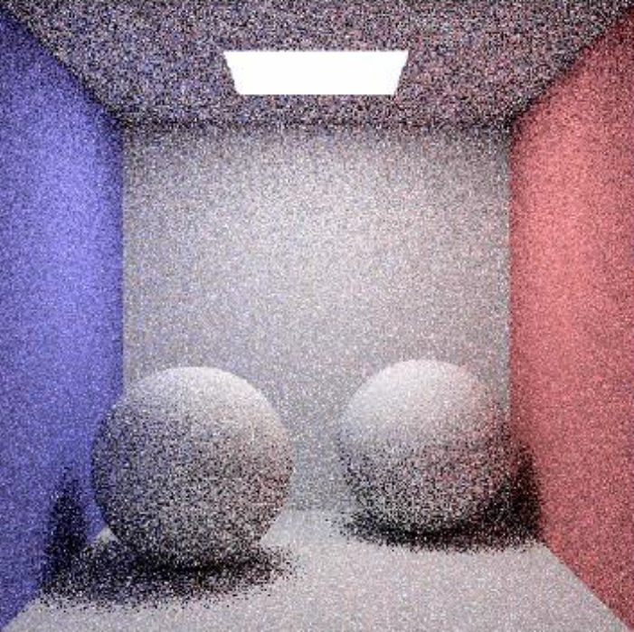
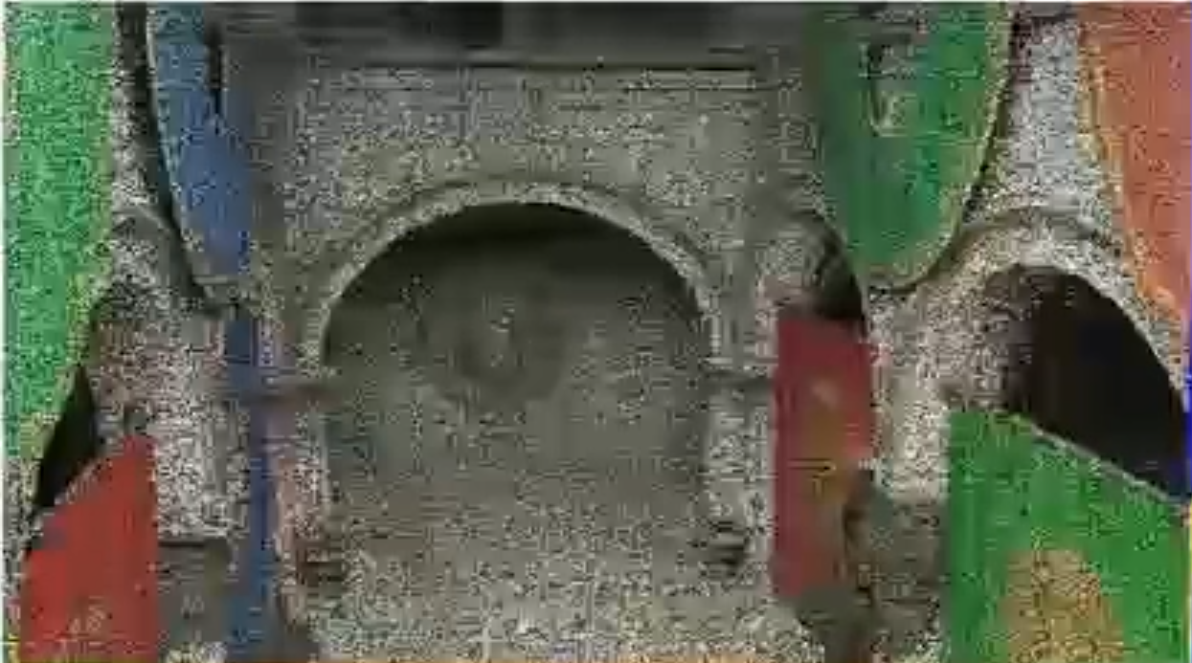
Background
Up to 2019, Ray-tracing frameworks can produce 1 sample per pixel(spp) in real-time [1][2][3]
1spp path tracing has a noisy result
[4]
1spp path tracing in paper
[5]
1spp Monte Carlo path tracing
[1] AMD. 2017. RadeonRays SDK. Online. Retrieved January 23, 2018 from https://github.com/GPUOpen-LibrariesAndSDKs/RadeonRays_SDK
[2] Steven G. Parker, James Bigler, Andreas Dietrich, Heiko Friedrich, Jared Hoberock,David Luebke, DavidMcAllister,MorganMcGuire, Keith Morley, Austin Robison,et al. 2010. Optix: A general purpose ray tracing engine. Trans. Graph. 29, 4 (2010).
[3] Ingo Wald, Sven Woop, Carsten Benthin, Gregory S. Johnson, and Manfred Ernst.2014. Embree: A kernel framework for efficient CPU ray tracing. Trans. Graph. 33,4 (2014).
[4] https://dl.acm.org/doi/abs/10.1145/3269978
[5] Sung-Eui Yoon, CS482 Lecture notes, 2021

Slide 3
Main contribution & path tracing setting
Denoising pipeline for 1 sample per pixel(spp) real-time path tracing
Path tracing set up in this paper
Light
Rasterized primary rays
Importance sampling
Next event estimation
(Toward to random light point)
[1] https://dl.acm.org/doi/abs/10.1145/3269978

Slide 4
Main idea
Examples of 1ssp path tracing outputs
First bounce surface normals
Some of the outputs data are noise free!
(feature buffer)
World positions
albedo
[1] https://dl.acm.org/doi/abs/10.1145/3269978

Slide 5
Overview
Preprocessing
Regression
Post-processing
Generate a bit cleaner input
Combine with noisy-free feature buffers
Guarantee temporal stability
[1] https://dl.acm.org/doi/abs/10.1145/3269978

Slide 6
Preprocessing
Whether previous data can be accumulated
Normals, positions & camera parameters
Motion vectors & discards
Accumulated noisy data
Noisy data without albedo
Temporal accumulation
Temporal accumulation: kind of moving average, mix 80% historical data and 20% current data
[1] https://dl.acm.org/doi/abs/10.1145/3269978

Slide 7
Regression – main idea
Use linear regression to map noise free feature buffer to original data
Use weights to recover noise free scene by noise-free feature buffer
$$α^{c}=arg\min_{α^{c}}{\sum_{\left(p,q\right)∈Ω_{i,j}}{(Z_{c}\left(p,q\right)−{\sum_{m=1}^{M}{α_{m}^{c}T_{m}(p,q}))}^{2} }}$$
$$c:channel, e.g. red, luminance$$
i,j
Separate image into blocks (32x32)
$$Y^{c}\left(q,p\right)=\sum_{m=1}^{M}{α_{m}^{c}T_{m}(p,q})$$
[1] https://dl.acm.org/doi/abs/10.1145/3269978

Slide 8
regression
Linear regression
Normals, positions
Noise-free feature buffers
Avoid rank deficiencies solving the linear regression
Stochastic regularization
Noisy normal & noisy positions
Accumulated noisy data
QR
Back substitution
Weighted sum
R
weights
[1] https://dl.acm.org/doi/abs/10.1145/3269978

Slide 9
Postprocessing
Motion vectors & discards
Motion vectors
albedo
Fitted image
Temporal accumulation
Temporal Anti-Aliasing[2]
[1] https://dl.acm.org/doi/abs/10.1145/3269978
[2] Brian Karis. 2014. High-quality temporal supersampling. In Proceedings of the ACMSIGGRAPH Advances in Real-Time Rendering in Games 2014.

Slide 10
Results
Runtimes for 720p frame
Method | Runtime | Hardware
Proposed BMFR | 2.5ms | AMD Vega Frontier Edition
Proposed BMFR(OpenCL) | 2.4ms | Nvidia TITAN X(Pascal)
SVGF[1] | 4.4ms | Nvidia TITAN X(Pascal)
[2] | 9.2ms | Nvidia TITAN X(Pascal)
[3] | 55ms | Nvidia TITAN X(Pascal)
GF[4] | 94ms | Nvidia GTX285
NFOR[5] | Minute | CPU
[1] Christoph Schied, Anton Kaplanyan, Chris Wyman, Anjul Patney, Chakravarty R. Alla Chaitanya, John Burgess, Shiqiu Liu, Carsten Dachsbacher, Aaron Lefohn, and Marco Salvi. 2017. Spatiotemporal variance-guided filtering: Real-time reconstruction for path-traced global illumination. In Proceedings of the Annual Conference on High Performance Graphics.
[2] Michael Mara, Morgan McGuire, Benedikt Bitterli, and Wojciech Jarosz. 2017. An efficient denoising algorithm for global illumination. In Proceedings of the Annual Conference on High Performance Graphics.
[3] Chakravarty Alla Chaitanya, Anton Kaplanyan, Christoph Schied, Marco Salvi, Aaron Lefohn, Derek Nowrouzezahrai, and Timo Aila. 2017. Interactive reconstruction of Monte Carlo image sequences using a recurrent denoising autoencoder. Trans. Graph. 36, 4 (2017).
[4] Pablo Bauszat, Martin Eisemann, and Marcus Magnor. 2011. Guided image filtering for interactive high-quality global illumination. Comput. Graph. Forum 30, 4 (2011).
[5] Benedikt Bitterli. 2016. Rendering Resources. Retrieved from https://benedikt-bitterli. me/resources/.

Slide 11
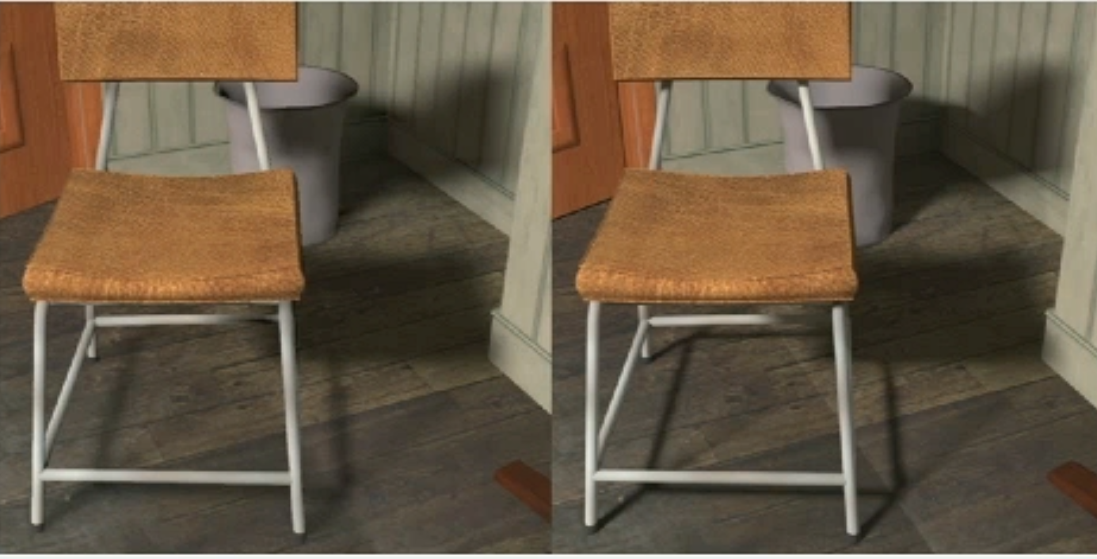
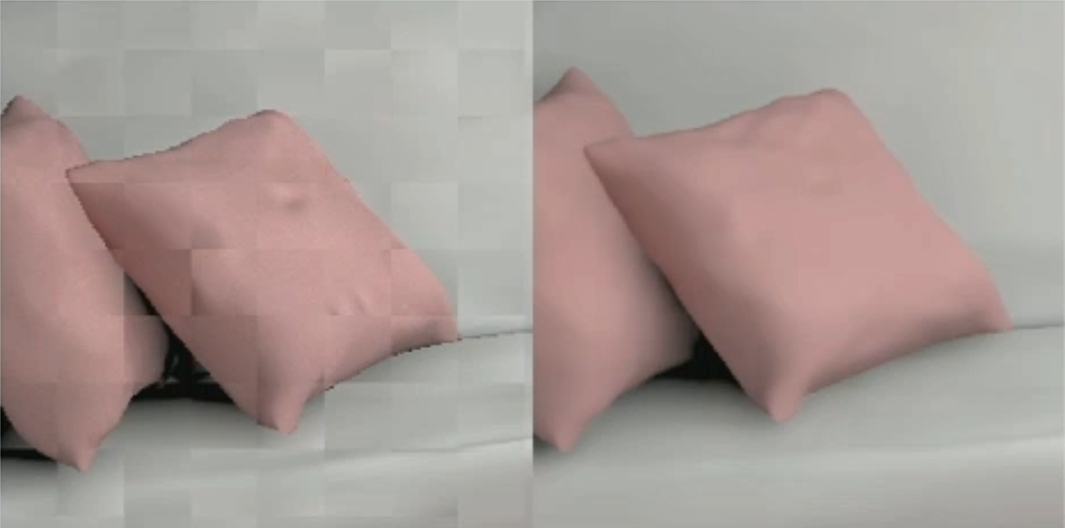
Limitations
Soft shadows and reflections
Block first frame
Proposed
4096 ssp
After accumulation
[1] https://dl.acm.org/doi/abs/10.1145/3269978

Slide 12
Limitations
Temporal lag
Artefacts in occlusions
[1] https://dl.acm.org/doi/abs/10.1145/3269978

